Slide 1

TIER-Plus overview and core functionality
Brooke Nichols, Boston University Prioritization under pressure: Rethinking HIV service delivery with TIER-Plus

Slide 2
Who is TIER-Plus for?

Slide 3
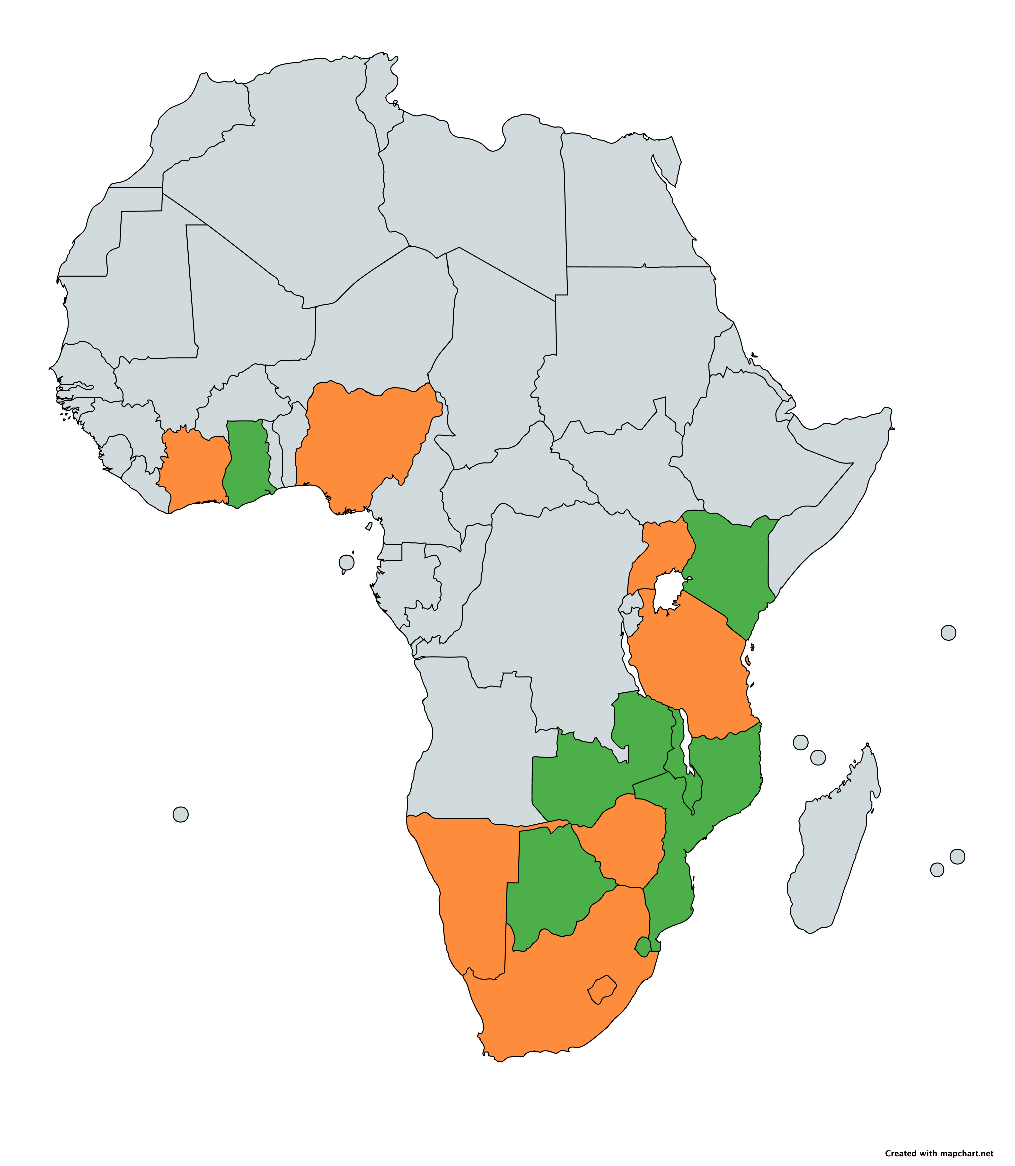
Uganda
Countries represented in TIER-Plus
Côte d’Ivoire
Ghana
Nigeria
Kenya
Baseline data values reviewed and updated by in-country teams
Tanzania
Malawi
Zambia
Baseline data values from publicly available resources and literature
Namibia
Mozambique
Zimbabwe
South Africa
Eswatini
Lesotho

Slide 4
The piloting phase
The piloting phase has resulted in several meaningful changes:
Feedback | Completed
PrEP targeting by sub-population
Updated costs
Output including cost breakdown by category of costs
Inclusion of 6-monthly clinical visits vs 12- monthly clinical visits
Model display improvements
Updated costs
Users able to update parameters
Adding additional countries
PrEP targeting to pregnant and breastfeeding women
Further results functionality
Changes to VL algorithm
~
~
~
~
Notes:
A few major changes have been made in response to the piloting phase. Some is behind the scenes (updating algorithms, baseline data), some is formatting and presentation of results, and some is adding additional functionalities that were requested (like being able to break down PrEP for different risk groups), and adding in a functionality to change the frequency of clinical visits for stable clients
(NOTE: add the assumption sheet here too)

Slide 5
TIER-plus is a living tool
We need and want your feedback to make TIER-plus as useful as possible!
What else would you like to see?
Please explore and provide feedback!

Slide 6
Thank you!

